Slide 1


District Counselor Meeting
December 5, 2024

Slide 2


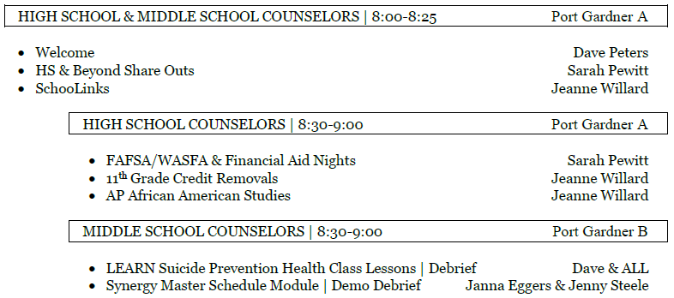
Today’s Agenda

Slide 3


HS & Beyond | Share-Outs

Slide 4
7th Grade Health Curriculum
Reasons for added videos:
LEARN Suicide Prevention
Appreciate Forefront’s thorough student training model
Students did not have enough exemplars to pull from during class discussion
Allowed for speaker respite (allowed co-teachers to check-in on one another and observe students)
Allowed for common language and message for all students – eliminated ‘presentation fatigue’
“Signs of Suicide” was familiar to 7th graders and age-appropriate, professional videos

Slide 5
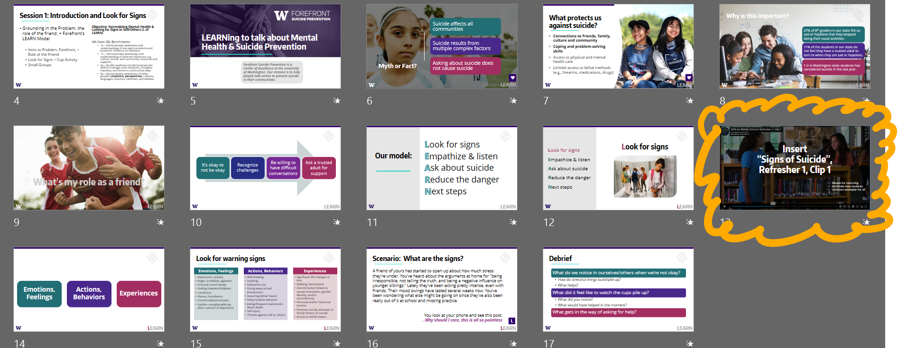

Slide 6
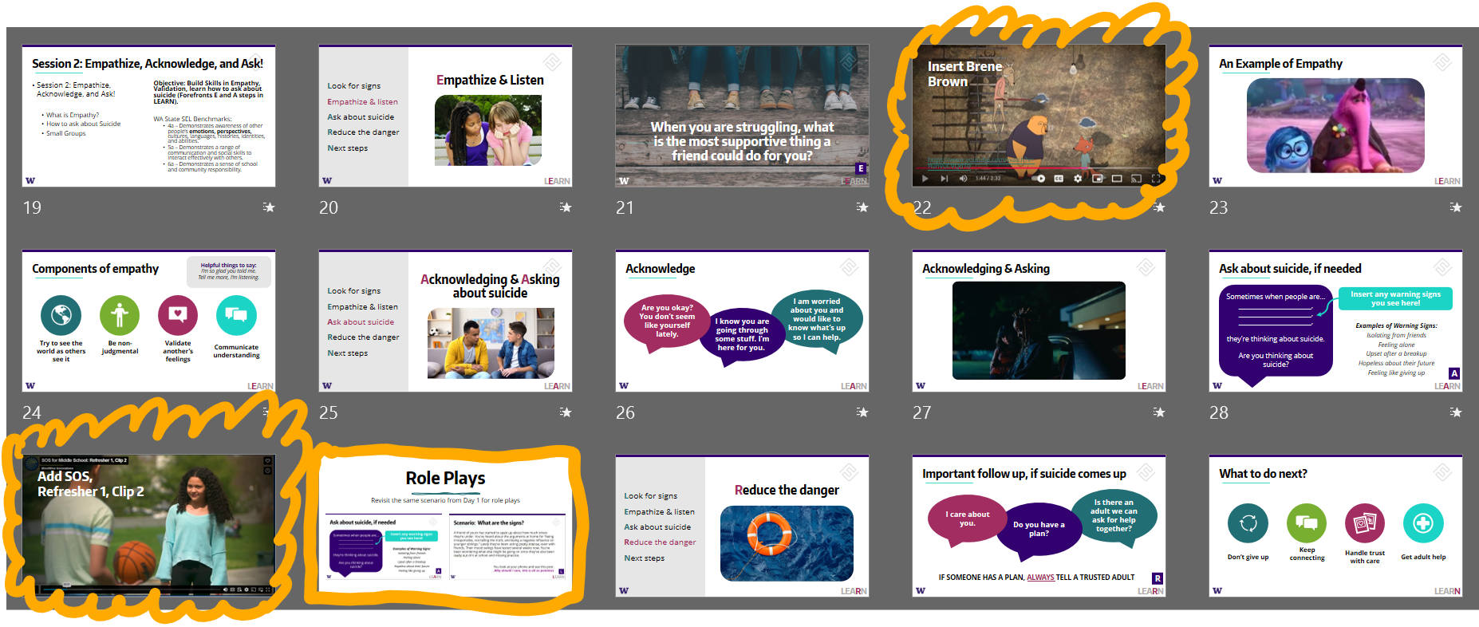

Slide 7


Happy Holidays!

